Slide 1
Final Project Attack

Slide 2
Motivation
Develop a novel method of generating adversarial samples that bypass ML-based static antiviruses.
Must take any Windows virus and modify it to evade antivirus detection
Must retain functionality.

Slide 3
Solution
Comparing all papers covering in this class, Dr. Botacin’s method proved to yield the highest evasion rates.
We decided to take the existing example on Github and augment it with improvements.

Slide 4
Baseline Attack
Combined Dr. Botacin’s filesystem.exe and inmemory.dll droppers into a single dropper that:
Compiled into an executable
Contained a single resource
XOR decrypted the resource
Base64 decoded the resource
Wrote the resource to file
Launched the resource
Dynamically loaded 90% of APIs
Encoded strings as int arrays
Mimicked the NTDLL.dll

Slide 5
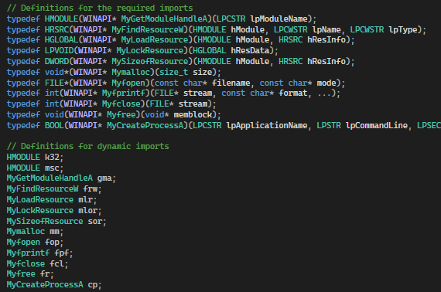
Baseline Attack Visualization

Slide 6
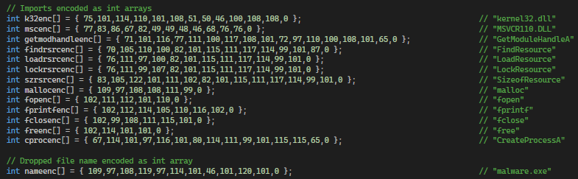
Baseline Attack Visualization

Slide 7
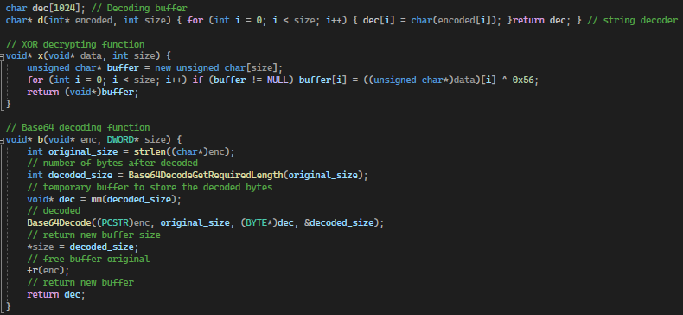
Baseline Attack Visualization

Slide 8
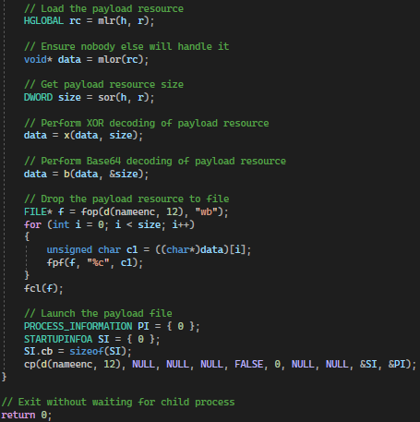
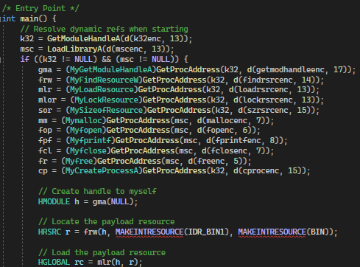
Baseline Attack Visualization

Slide 9
Attack v1 Summary
A list of improvements added:
Removed all but 3 static APIs from original attack
GetModuleHandleA
GetProcAddress
LoadLibraryA
Replaced original handle reference to Kernel32.dll
Further encrypted the int arrays by applying ROT1
Implemented manual Base64 decoding

Slide 10
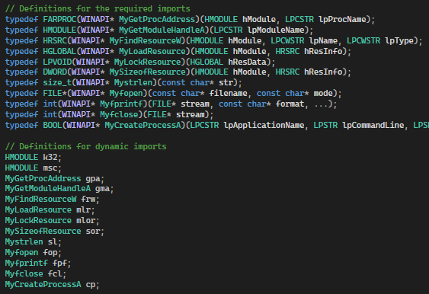
Attack v1 Visualization

Slide 11
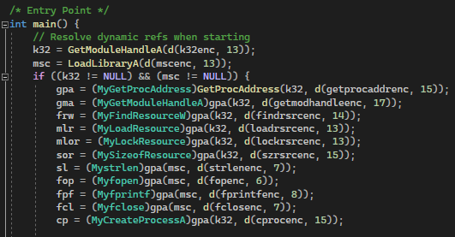
Attack v1 Visualization

Slide 12
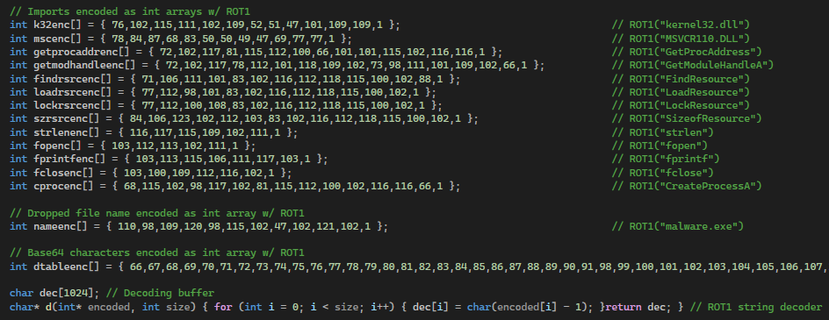
Attack v1 Visualization

Slide 13
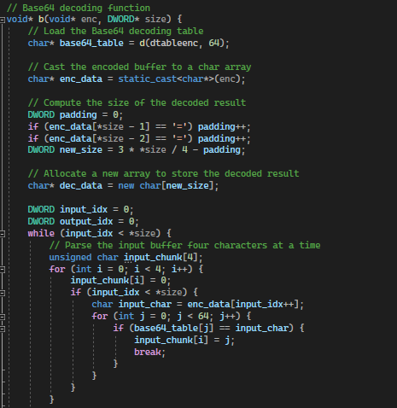
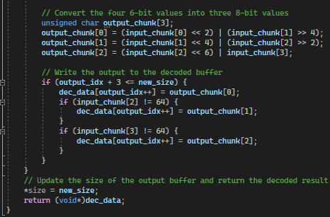
Attack v1 Visualization

Slide 14
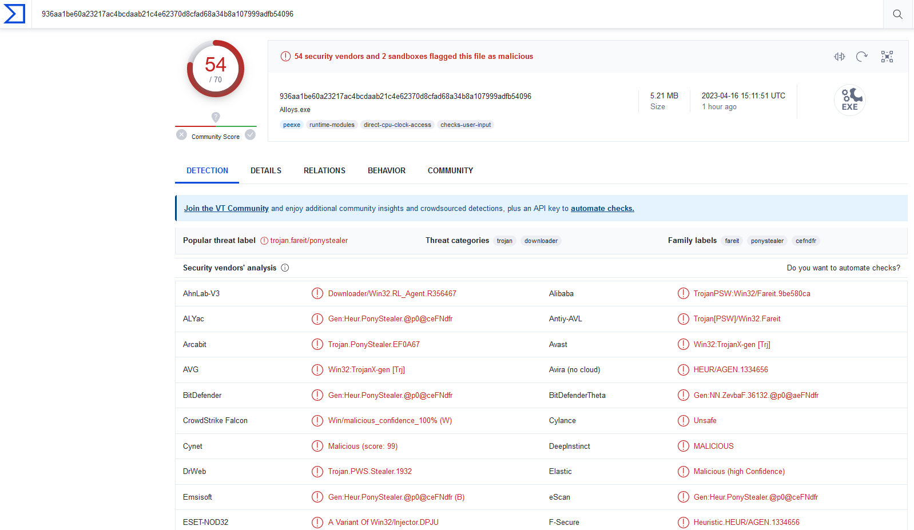
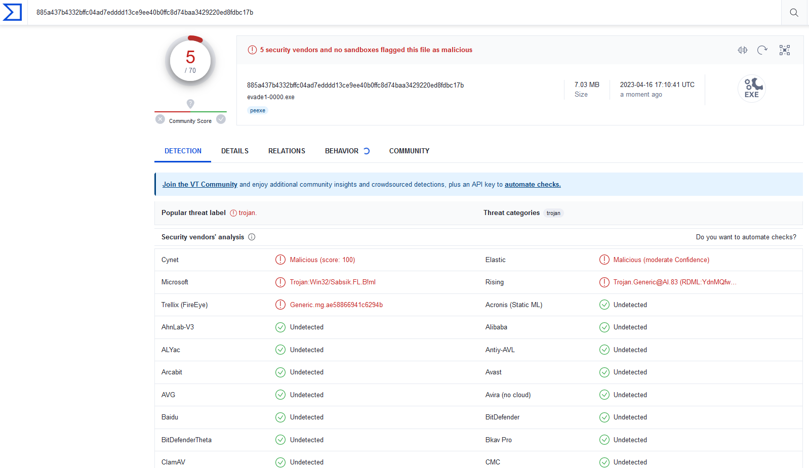
Attack v1 Results
VirusTotal of Evade1-0000 before and after
Before
After

Slide 15
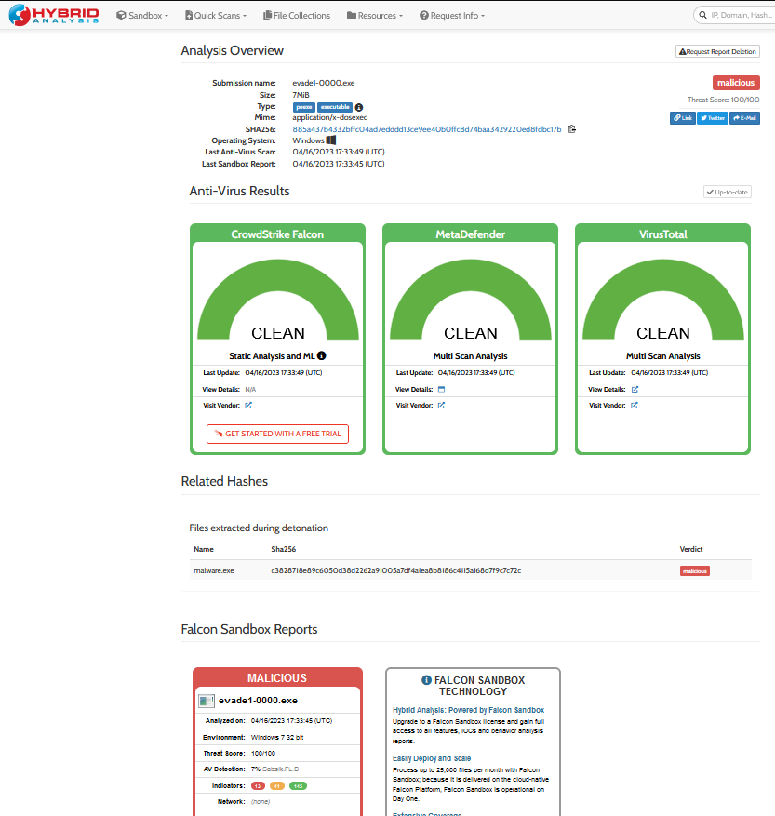
Attack v1 Results
Hybrid Analysis

Slide 16
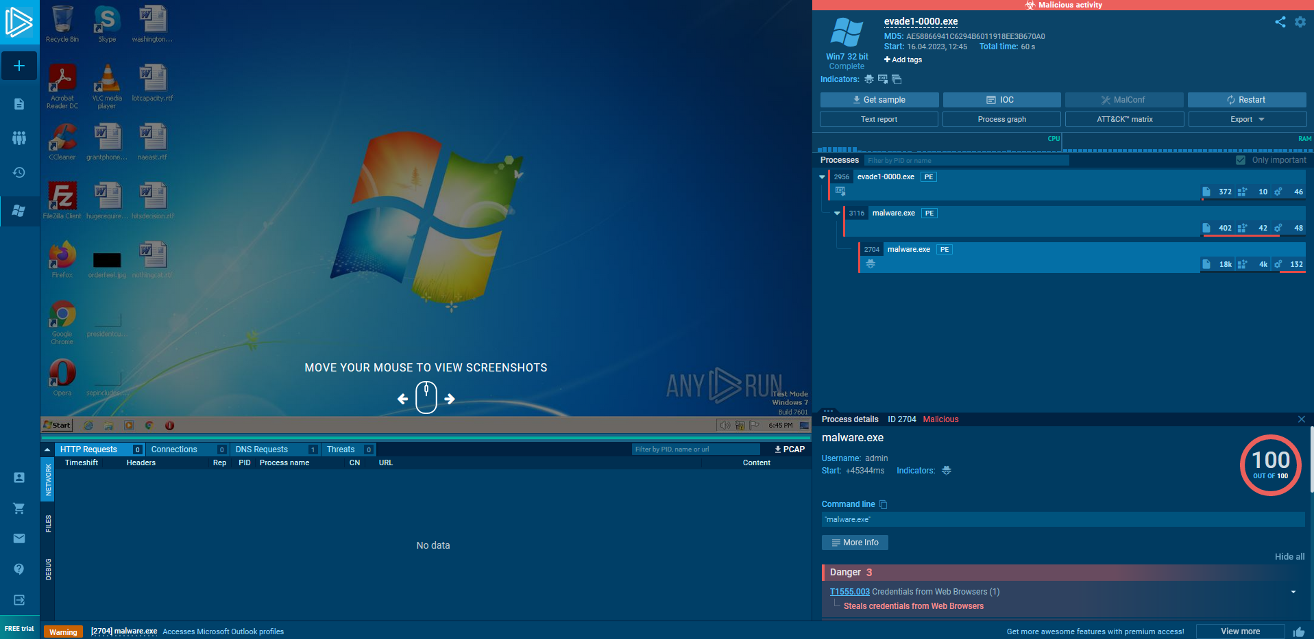
Attack v1 Results
Sandbox Execution

Slide 17
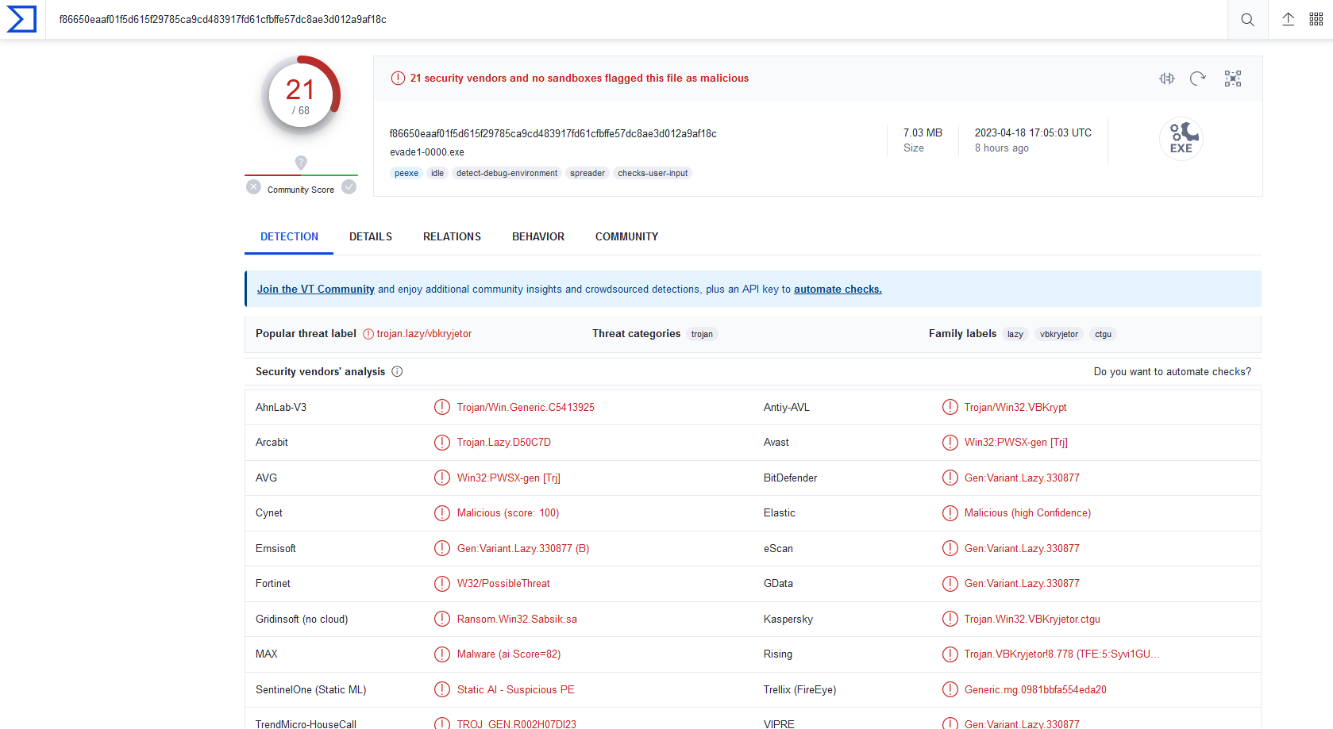
Attack v1 Additional Note
Changing nothing and running Evade1-0000 24 hours later
Indicates industry information sharing and quick retrain

Slide 18
Attack v2 Summary
A list of improvements added:
Manually parsed Kernel32.dll to find GetProcAddress
Added dynamic reference for LoadLibraryA
Implemented manual computation of int array length
Implemented manual conversion of GETINTRESOURCE
Added error checking at each stage of dynamic loading

Slide 19
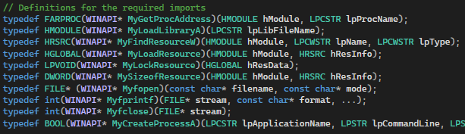
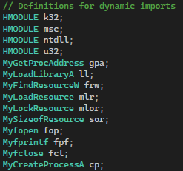
Attack v2 Visualization
Reduced dynamic APIs

Slide 20
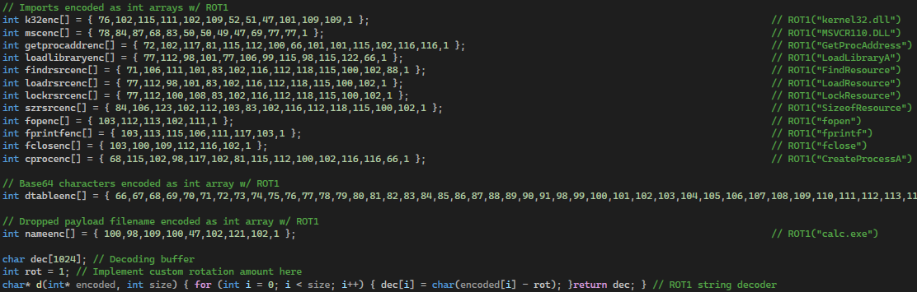
Attack v2 Visualization
Reduced encoded API strings

Slide 21
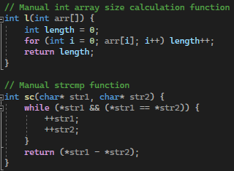
Attack v2 Visualization
Manual int array size calculation and strcmp

Slide 22
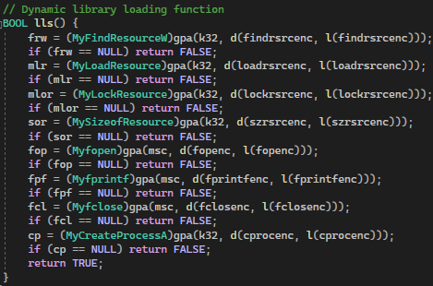
Attack v2 Visualization
Library loading error checking and abstraction

Slide 23
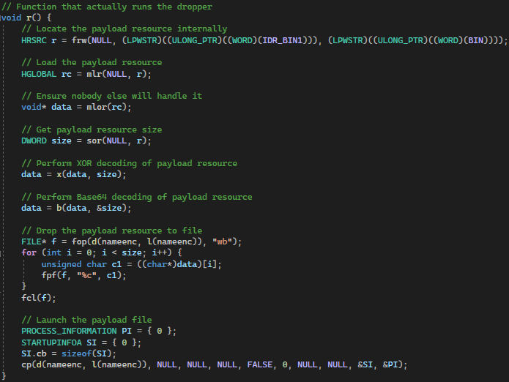
Attack v2 Visualization
Actual dropper run abstraction and GETINTRESOURCE obfuscation

Slide 24
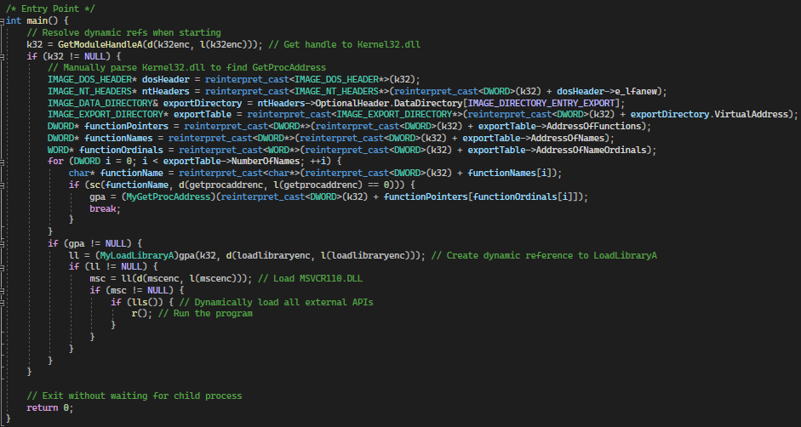
Attack v2 Visualization
Final main with manual Kernel32.dll parsing and dynamic loading

Slide 25
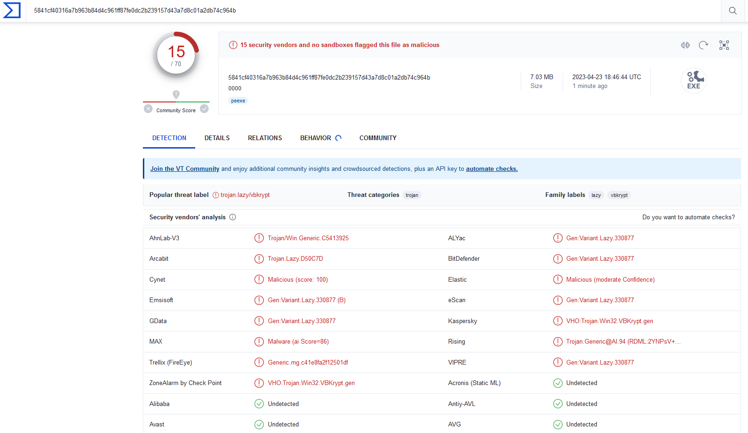
Attack v2 Results
VirusTotal of Evade1-0000

Slide 26
Attack v3 Summary
A list of improvements added:
Added 60 second wait timer before execution
Added sandbox environment detection
Added debugger detection

Slide 27
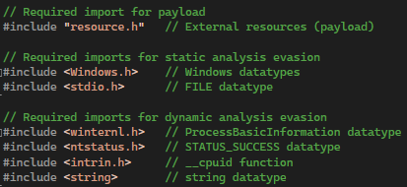
Attack v3 Visualization
New imports for dynamic analysis evasion

Slide 28
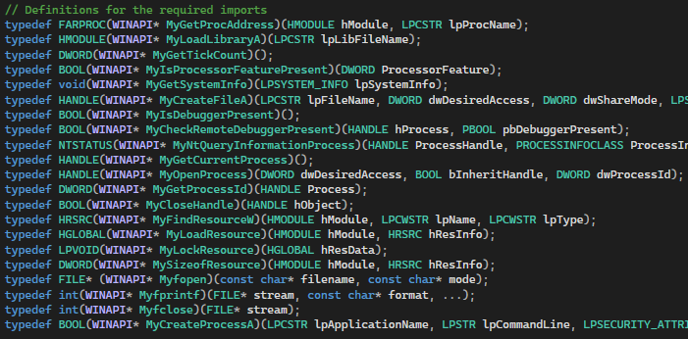
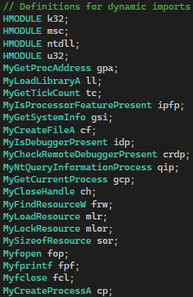
Attack v3 Visualization
New dynamic imports for dynamic analysis evasion

Slide 29
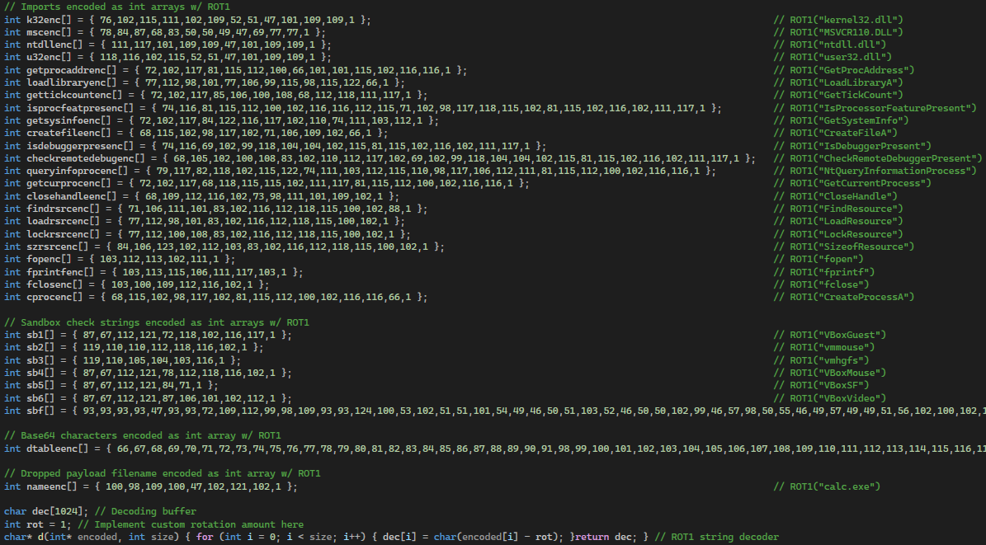
Attack v3 Visualization
New encoded API strings for dynamic analysis evasion

Slide 30
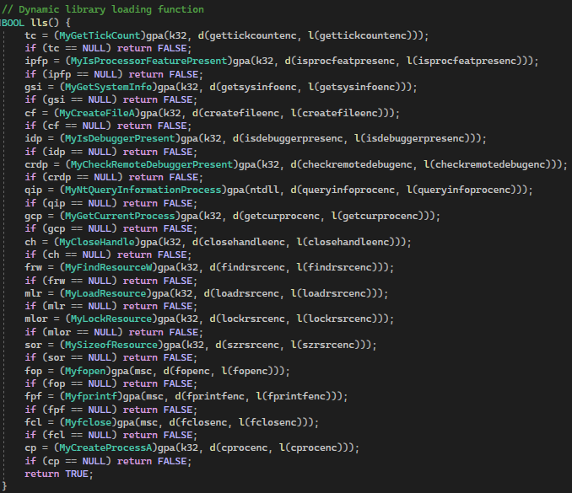
Attack v3 Visualization
Loading of new dynamic APIs for dynamic analysis evasion

Slide 31
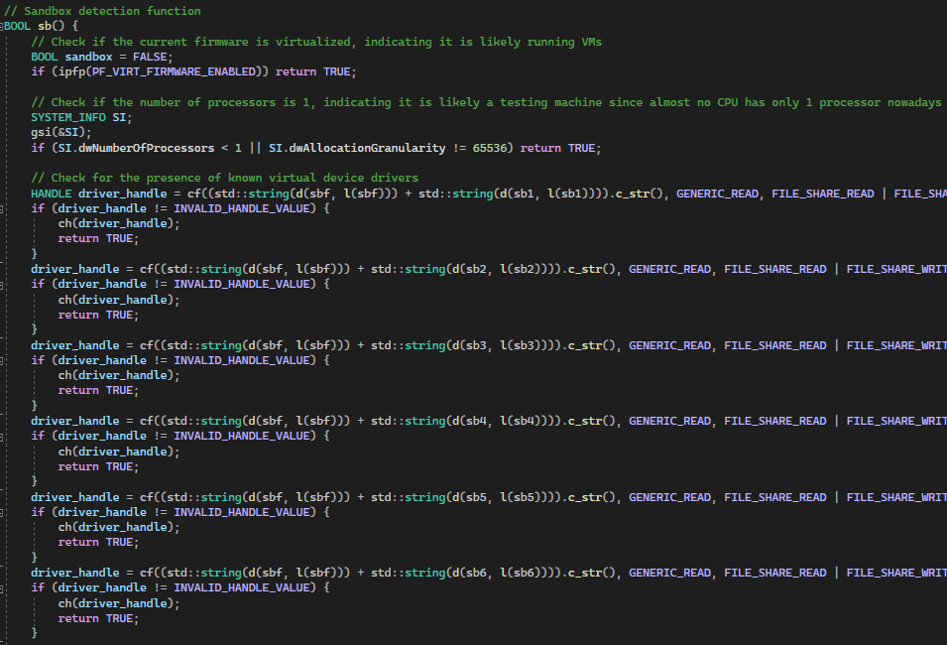
Attack v3 Visualization
Sandbox environment detection for dynamic analysis evasion (Ch1-3)

Slide 32
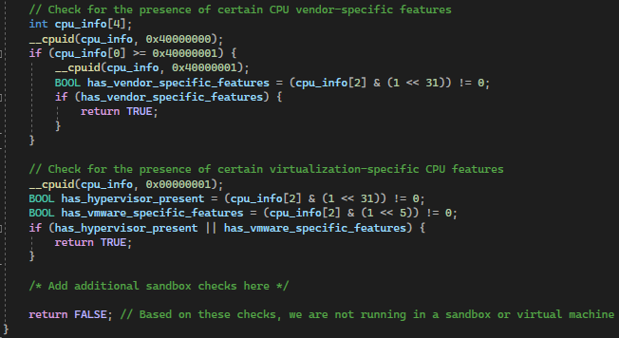
Attack v3 Visualization
Sandbox environment detection for dynamic analysis evasion (Ch4-5)

Slide 33
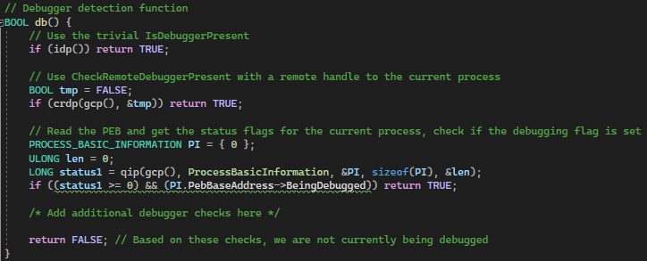
Attack v3 Visualization
Debugger detection for dynamic analysis evasion

Slide 34
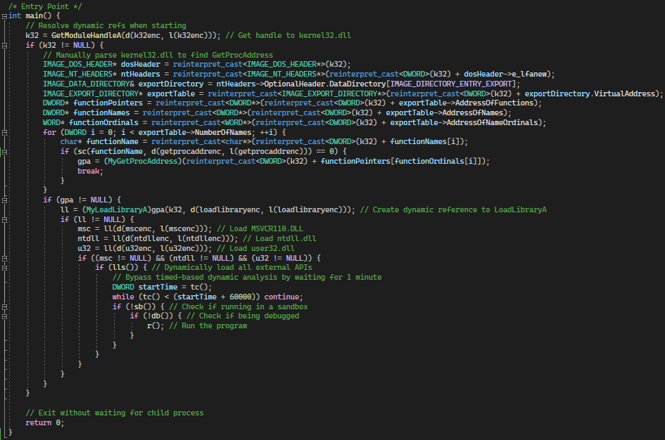
Attack v3 Visualization
Final main with 1 minute wait timer to evade dynamic analysis

Slide 35
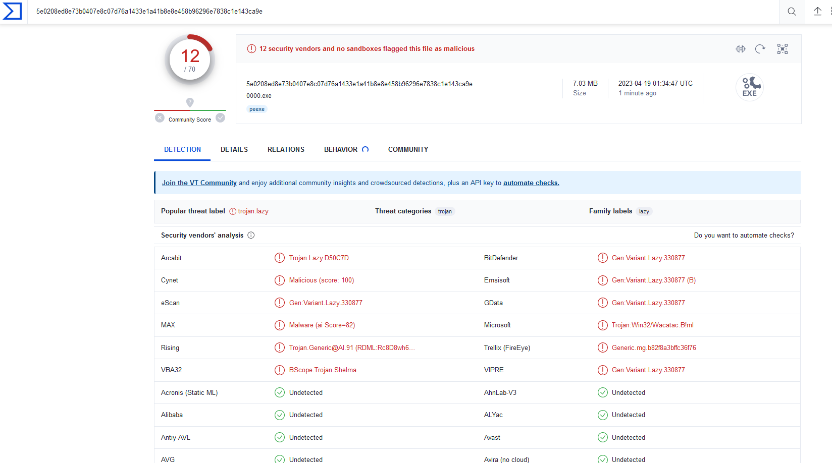
Attack v3 Results
VirusTotal of Evade1-0000

Slide 36
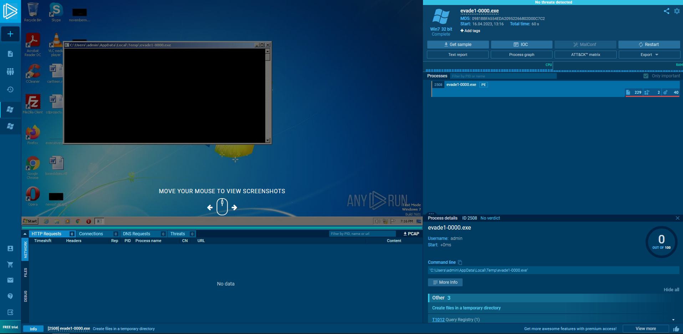
Attack v3 Results
Sandbox Execution

Slide 37
Attack v4 Summary
Noticed that not a single sample evaded Yasir’s model
Found invalid PE handling in Yasir’s model
Exploited Yasir’s model to force a benign classification
A list of improvements added:
Created benign stager that runs after compilation and before execution

Slide 38
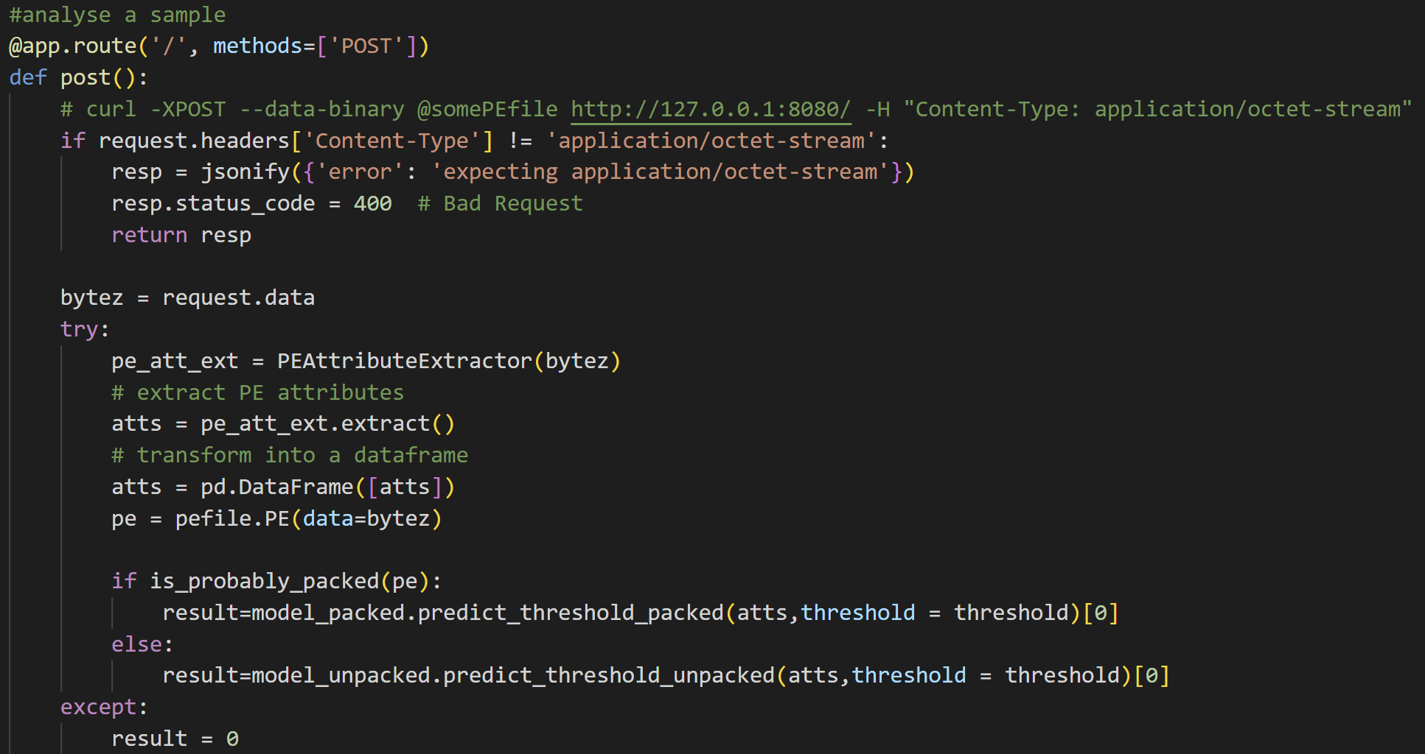
Attack v4 Visualization
Vulnerability in Yasir’s model (all errors return benign)

Slide 39
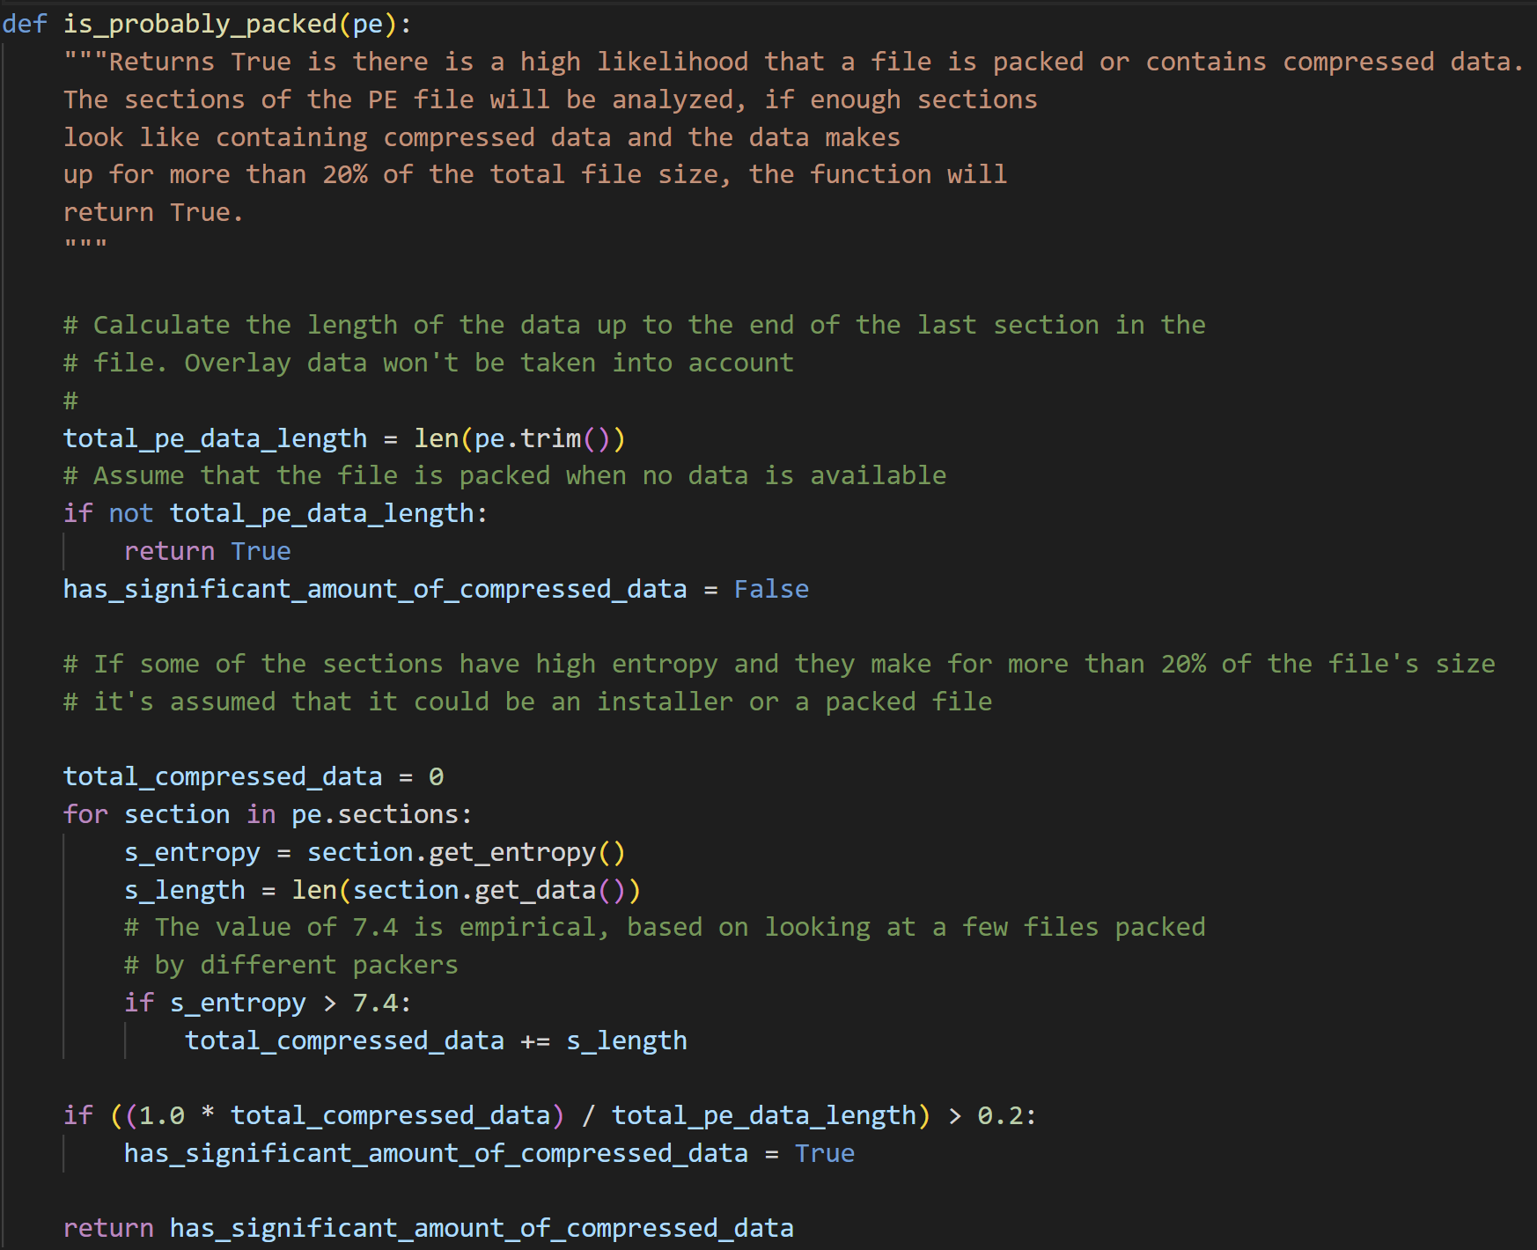
Attack v4 Visualization
Vulnerability in Yasir’s model (should use hasattr before access)

Slide 40
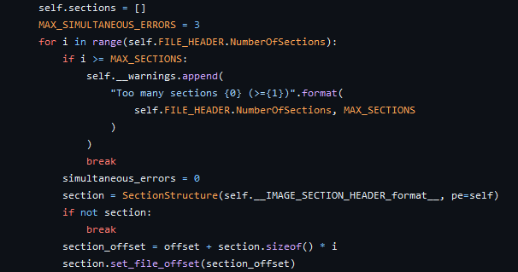
Attack v4 Visualization
Pefile section gathering function

Slide 41
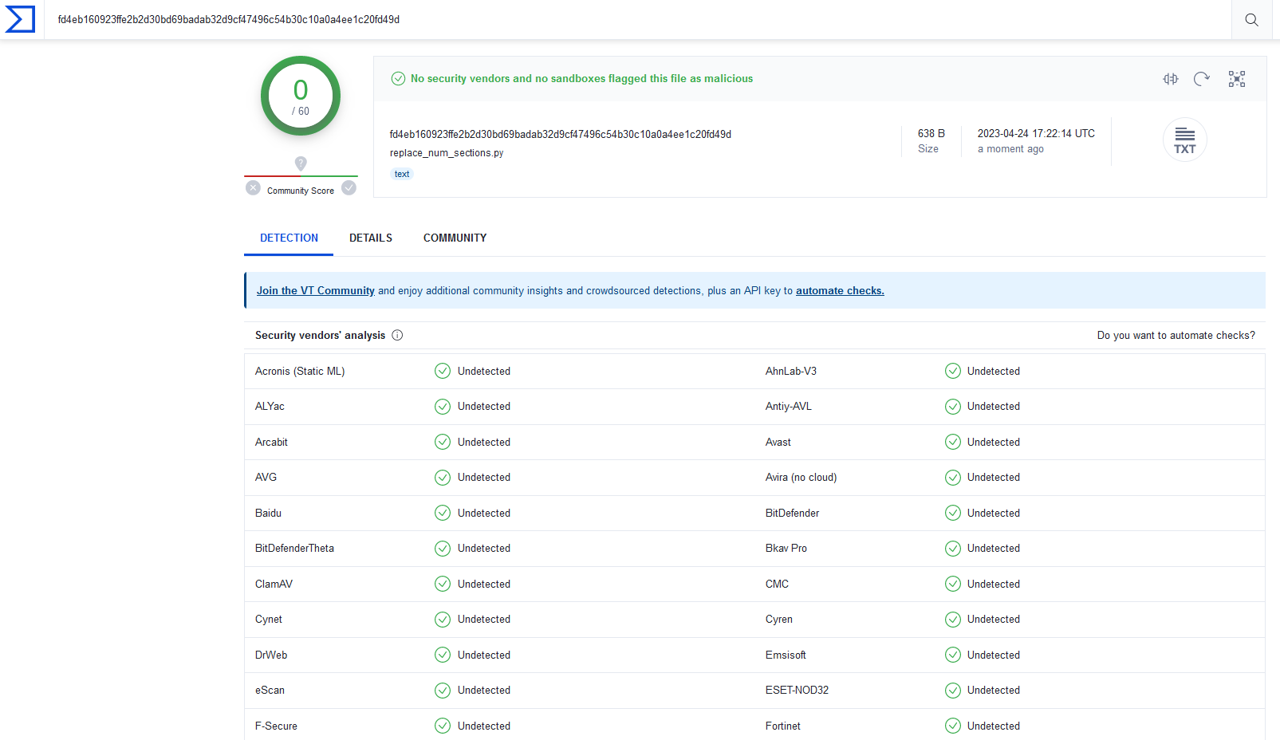
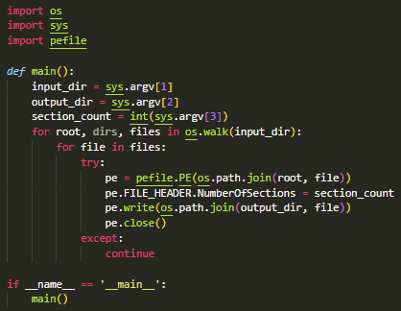
Attack v4 Visualization
Program to modify each executable NumberOfSections

Slide 42
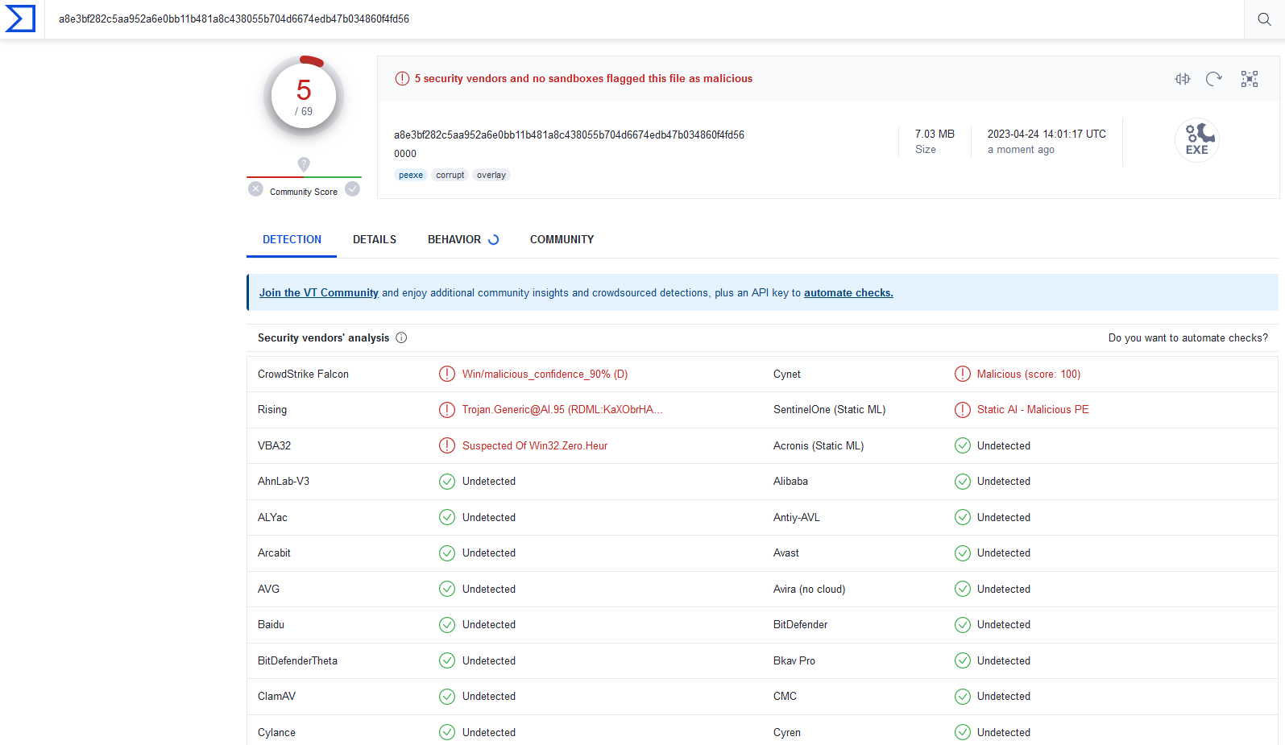
Attack v4 Results
VirusTotal of Evade1-0000 (dynamic evasion disabled)

Slide 43
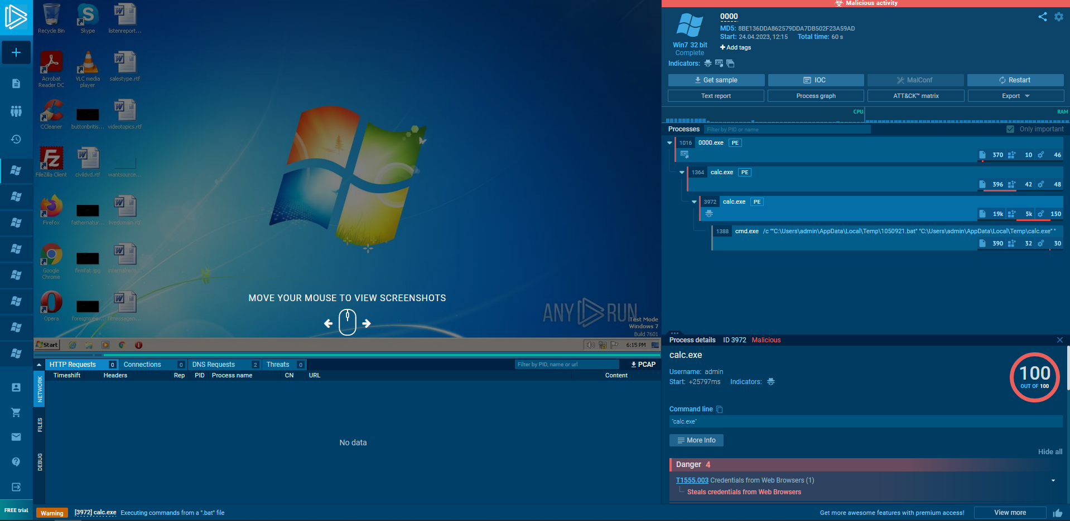
Attack v4 Results
Sandbox Execution (dynamic evasion disabled)

Slide 44
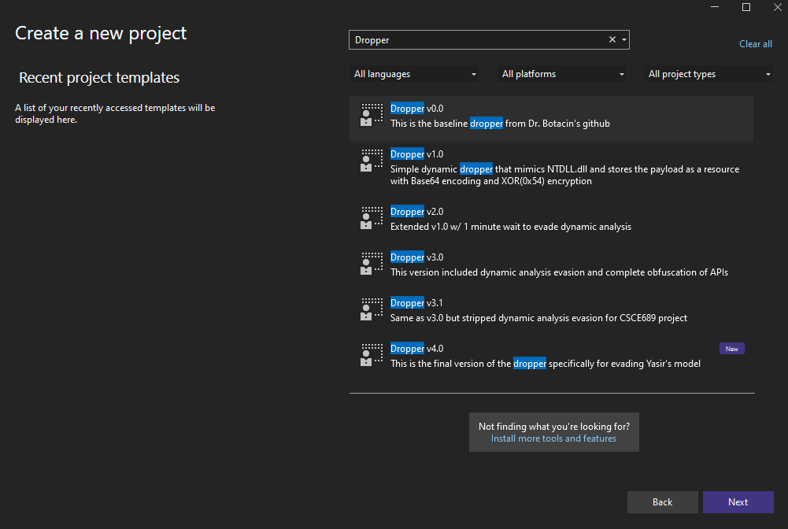
Additional Tools – VS Ease of Use

Slide 45
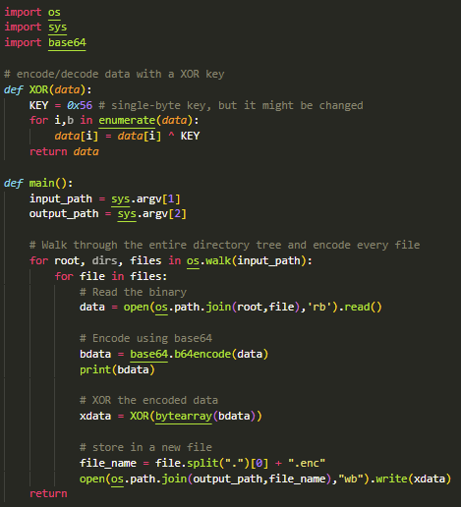
Additional Tools – Creating Encoded Resources

Slide 46
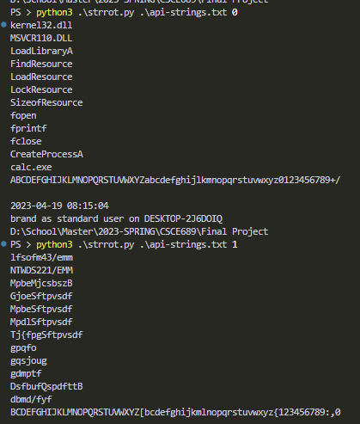
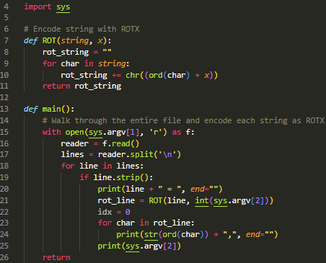
Additional Tools – Creating ROT1 int Arrays

Slide 47
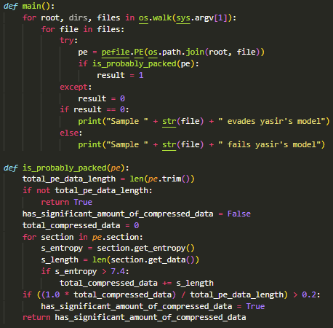
Additional Tools – Testing Yasir’s Vulnerability

Slide 48
Future Work
Embed dropper in different file type
Python executable (auto-py-to-exe) [1] [2]
Excell plugin (XLL) [1] [2]
Incorporate different method to launch process
Inject into own process then return execution after [1]
Doppelgӓng another legitimate process [1]
Add more sandbox and debugger detection methods
Wait to execute until after reboot [1]
Lock kernel32.dll to prevent analysis programs from using [2]

